Slide 1



Endangered Animals Classification using CNN
Presented By:
Aditya Satheesan (503)
Siddhesh Bangar (504)
Samrudhi Jagadale (512)
Zaid Khalfe (518)

Slide 2
Introduction
Literature Review
Objective
Endangered Animals
Proposed System
Dataset used
Methodology
System Requirements
Implementations
Results
Conclusion
Future Scope
References
CONTENTS

Slide 3
INTRODUCTION
Our Classification System is a system that identifies the animal by its image.
And it then lets the user know whether the animal is endangered or not.
Our project uses image dataset and uses Convolutional Neural Network (CNN) to give us the no of endangered animals remaining in the wild.

Slide 4
LITERATURE REVIEW
Author name | Paper Name | Summary
Fagerlund | Animal Species Recognition Using Support Vector Machines (2007) | Using Support Vector Machines (SVM) and K-nearest Neighbours (KNN) algorithms to classify animal species based on their visual features.
B. Qiao, Z. Zhou, H. Yang and J. Cao | Animal species recognition based on SVM Classifier and Decision Tree (2010) | Proposed a method for animal classification using an SVM decision tree. The approach achieves a correct classification rate of about 84%, with accuracy varying based on the visual feature.
Branson | Animal Species Categorization Using Pose Normalized Deep Convolutional Nets (2014) | He proposed a deep convolutional neural network for animal species categorization using pose normalization achieved an accuracy of 85.4%.
R. Roslan, N. A. Nazery, N. Jamil and R. Hamzah | Color-based animal image classification using Support Vector Machine(2009) | Colour-based extraction of attributes is suggested. Using the Support Vector Machine technique, nine colour-based features are examined. An overall precision of 97.14% for training data and 98.33% for the test data

Slide 5

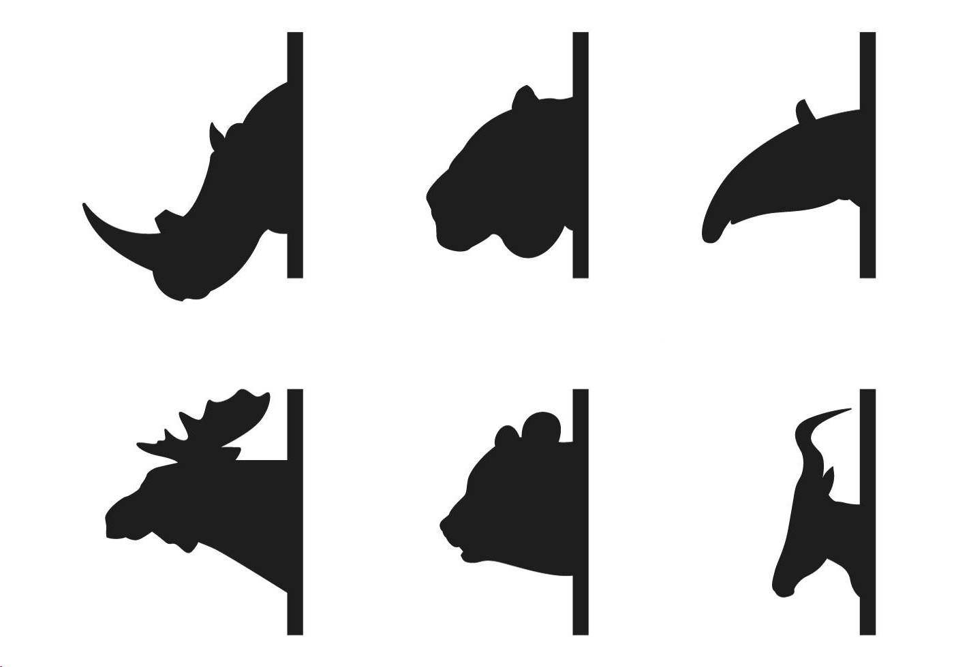

OBJECTIVE
To emphasize the value of utilizing technology to safeguard and maintain endangered animal populations.
Classify multiple different types of animals using convolution image classifier.
Identify endangered species.

Slide 6

ENDANGERED ANIMALS
Animals that face a high risk of extinction in the near future.
Their populations have declined significantly, often due to various human activities, such as habitat destruction, poaching, and climate change.
The loss of biodiversity that results from their extinction can have far-reaching ecological consequences.
Conservation efforts are crucial to protect and preserve these animals, as they play essential roles in maintaining the balance of ecosystems and contributing to the overall health of our planet.

Slide 7

PROPOSED SYSTEM
Problem Statement: Human activities such as deforestation, climate change, and pollution are causing the loss of habitats and food sources for animals, leading to declines in populations and even extinctions. So a proper system is required to classify endangered animals.
Solution: The resolve this problem where a machine learning project is created in which users can enter the image of the animal and it will show if it is endangered or not.

Slide 8
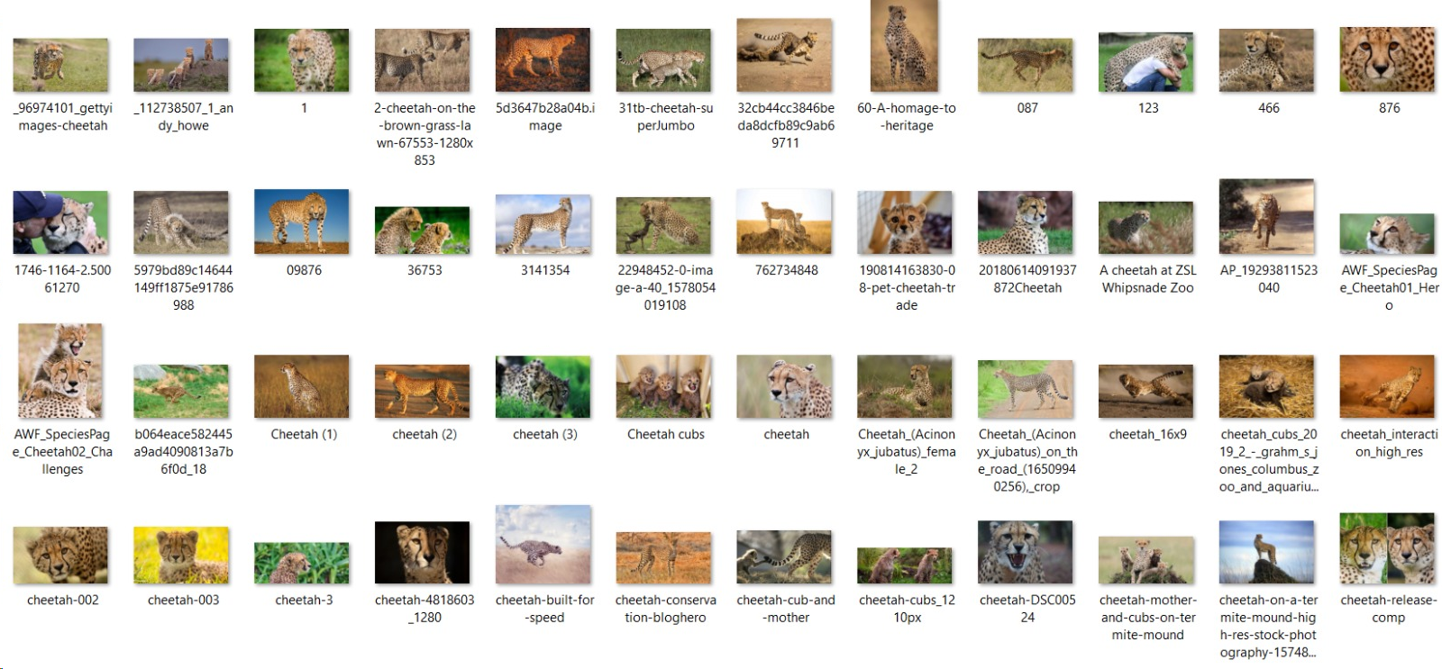
DATASET USED
Endangered animals dataset of 7289 animal images were used

Slide 9
METHODOLOGY
Primary
Source:
The primary source for the endangered animal classification is the unique dataset created by combining pre-existing datasets from Kaggle. Due to this the amount of data increases along with the quality of usable dataset.
Secondary Source:
The language used to implement this idea was python. Also the use of a Jupyter Notebook and Google Colab was identified.

Slide 10

SYSTEM REQUIREMENTS
SOFTWARE
Windows 10 OS
Python 3.10.8
Google Colab or Jupyter Notebook
HARDWARE:
8 GB RAM
256 GB SSD
i5 10th Gen Processor

Slide 11
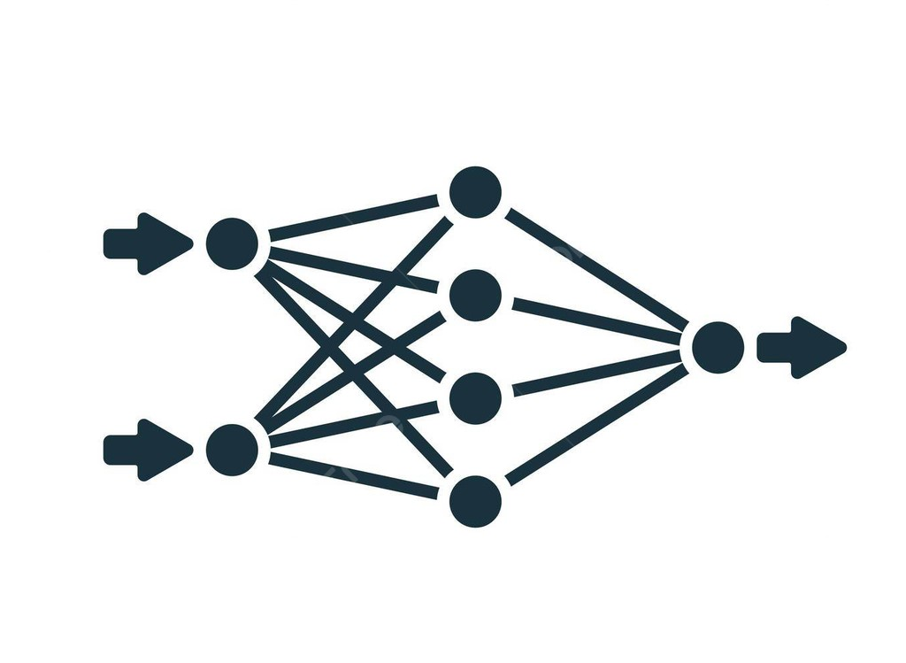
CNN MODEL
Deep learning model for image analysis.
Convolutional layers extract hierarchical features from input data.
Pooling layers reduce spatial dimensions.
Fully connected layers make classification decisions.
Effective for tasks like image recognition, object detection, and image segmentation.

Slide 12
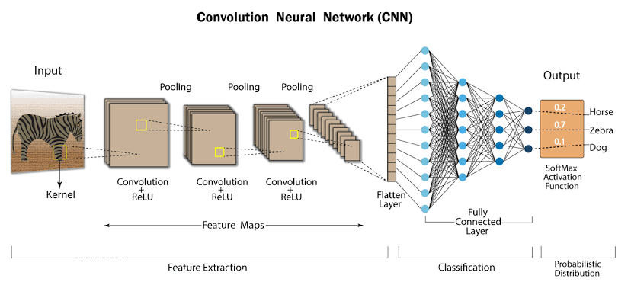
CNN MODEL

Slide 13
IMPLEMENTATION
Importing Libraries
2. Preprocessing
Data
3. Model Creation
Sequential model
Layers: Flatten, Dense, Dropout
Activation: Relu, Softmax function
Images were divided into Test, Train and Validation folders and ImageData Generator
Pandas, Numpy, Tensorflow, Keras, Sklearn, Matplotlib.

Slide 14
IMPLEMENTATION
4. VGG
Evaluating
model
6. Building the website
VGG architecture was used to apply CNN Model
Testing the model
for
predictions.
Developing a
website to integrate the model

Slide 15
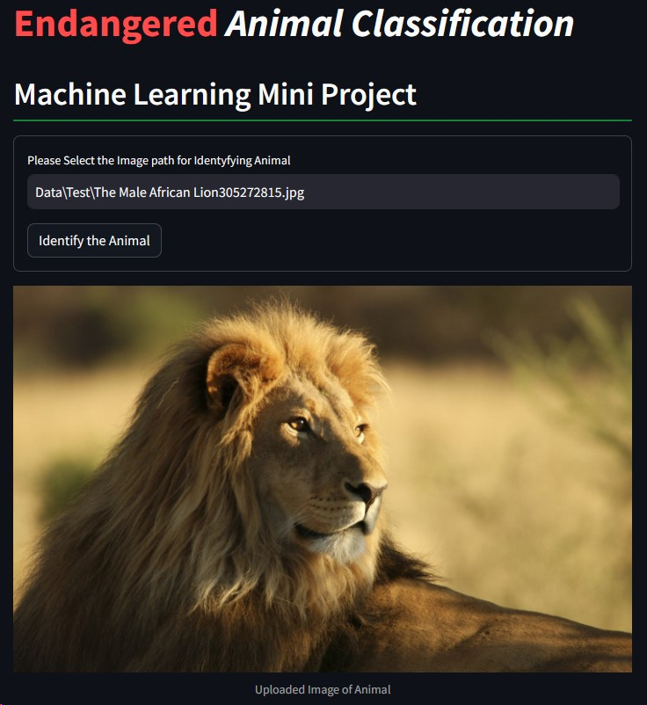
RESULT

Slide 16
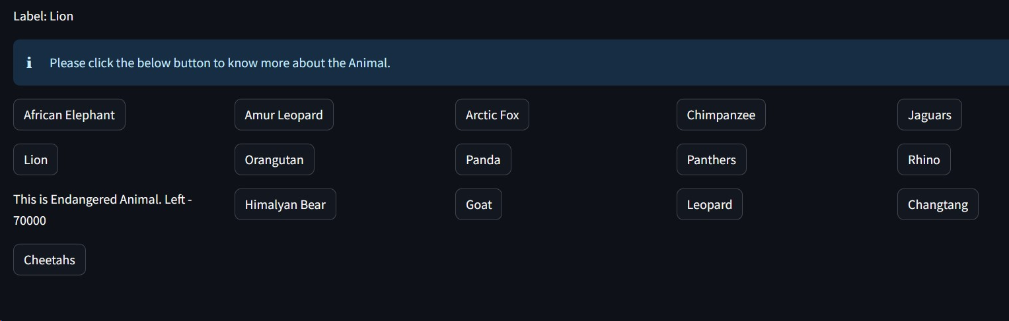
RESULT

Slide 17



ADVANTAGES
Identify various animal species
Create awareness about endangered species

Slide 18
LIMITATIONS
Time consuming training process
Requires huge and accurate dataset
Small errors can cause huge setback

Slide 19

CONCLUSION
In conclusion, this study introduces a novel methodology for classifying endangered animal species utilizing advanced machine learning techniques. The proposed method achieved an accuracy of 93% in identifying animal species based on their images. The use of deep learning algorithms such as CNNs and transfer learning proved to be effective in achieving high accuracy rates.

Slide 20

FUTURE SCOPE
The model can be extended to include more animal species
By adding more features such as audio recordings of animal calls and interactive maps of animal habitats.
Integrated into a mobile app for easier access
Classify other animal species, such as mammals and reptiles

Slide 21
REFERENCES
[1] Fagerlund, S. Animal Species Recognition Using Support Vector Machines. EURASIP J. Adv. Signal Process. 2007, 038637 (2007).
https://doi.org/10.1155/2007/38637
[2] R. Roslan, N. A. Nazery, N. Jamil and R. Hamzah, "Color-based animal image classification using Support Vector Machine," 2009 IEEE 6th Global Conference on Consumer Electronics (GCCE), Nagoya, Japan, 2009, pp. 1-5, doi: 10.1109/GCCE.2017.8229492.
[3]B. Qiao, Z. Zhou, H. Yang and J. Cao, "Animal species recognition based on SVM classifier and decision tree," 2010 First International Conference on Electronics Instrumentation & Information Systems (EIIS), Harbin, China, 2010, pp. 1-4, doi: 10.1109/EIIS.2017.8298548.

Slide 22
THANK YOU

